Slide 1
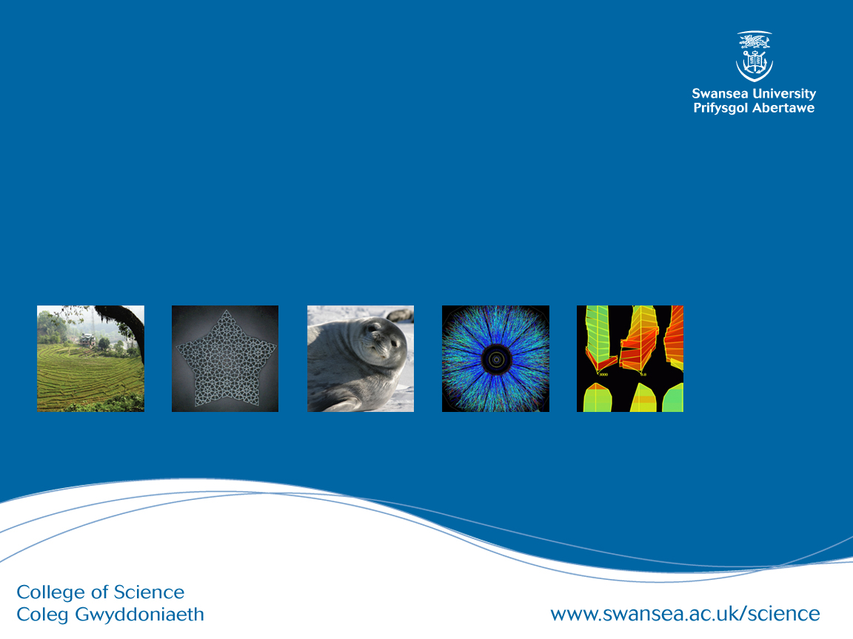
CSC349 User Experience
Practical 2 – Scoping and Capturing User Experience

Slide 2
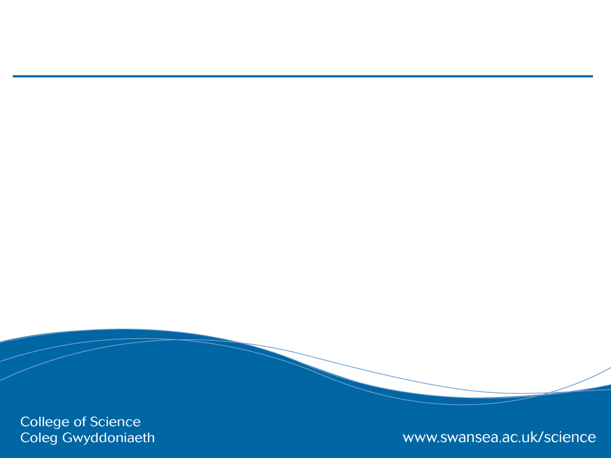
Practical Overview
In lectures we have talked about the challenge of capturing User Experience and we have talked about the challenges associated with converting information from scoping into something useful for an ongoing design process
In this lecture we will:
Look at how we can convert data from the scoping process into Persona’s
Revisit the sketching concept driven by this idea
Examine how we can organise design information using design games
Talk about storyboarding to portray User Experience
Take a break
After this we will move on to start to address a real world problem (group)
Multiple techniques you can implement suggested (group)

Slide 3
Design challenge 1 A:
Design to Support Study Online
Student information services are typically not the best, they are divided across multiple platforms and often fail to prioritise the most relevant information. For this exercise, sketch 10 novel ways that you might improve on student information services.
Assumptions
Students all have access to any relevant technology
You can seamlessly grab data of interest as needed

Slide 4
Design challenge 1 B:
Improving Campus Computer Clusters
Student information services are typically not the best, they are divided across multiple platforms and often fail to prioritise the most relevant information. For this exercise, sketch 10 novel ways that you might improve on computer cluster access on campus
Assumptions
Students all have access to any relevant technology
You can seamlessly grab data of interest as needed

Slide 5
Scoping Technique: Interviewing
One-to-one or one to many conversations that are used to understand the area you need to work in
Asking your participants questions and recording their answers
Are also often used in conjunction with the following:
Direct observations (since interviews are retrospectively subjective meaning people make sense of what happened)
To elaborate on surveys (prompting material)
To discuss diaries
To augment the results of user studies

Slide 6
Interviewing: Types of questions
Open (any response) vs. closed (single word response) questions
Keep them simple (no jargon/technical content)
Avoid multi-part/extensively staggered questions (if this then that otherwise this etc.)
Can use a mix of closed, then open questions etc
Get people to do things, draw things out, show you round their workplace

Slide 7
Interview Structures
Structured
when studying ‘variation’ to your ‘constant’
most analytical and, can actually gather quantitative data (think Likert scale analysis)
Semi-structured
most common
allows for pre-determined topics and follow-ups
Exploratory
often used pre-study for early-research when you don’t know exactly what to ask people

Slide 8
Semi structured interview: Topic Guide
Used to guide your discussion with the participants of a study
What do you want to know?
Alternatively, how important are the different topics you want to discuss?
Sort topics by ease of discussion (so long as the interview isn’t going to go on for to long)

Slide 9
Design challenge 1:
Interviews
Continuing on the same topic, you are now going to work in pairs to run a semi-structured interview. You will run 1 x 5 minute Interview and be Interviewed as a user (not designer) for 5 minutes.
Create a Topic Guide remembering the basic principles we have been over:
open vs closed questions
not leading people with questions
creating lot’s of variations on a topic

Slide 10
Focus Groups
One or more facilitators and many participants (4-8 typically)
Co-questioning – participants eliciting information from each other allows you to elicit information you wouldn’t get otherwise because you wouldn’t think to ask about it
Clue in the researcher's name: facilitator vs. interviewer
Can allow for more personal discussion
Or it can have the opposite effect

Slide 11
Focus Group Specific Issues
Should you be filming this sort of interaction, think about the pro’s and con’s
Might you need two facilitators?
Encouraging intra-group discussions and co-questioning
Has anyone else had similar experiences?
Do you agree with that?
Is this related to what you were saying?
How are you going to deal with the loud ones in the group?
What’s going to be the proper room set up?
Are you going to be working with existing groups?

Slide 12
Design challenge 1 A/B:
Focus Groups
Continuing on the same topic, you are now going to work in teams to facilitate a Focus Group. You will run 1 x 5 minute Focus Group and be a part of 2 x 5 minute groups.
Create a Topic Guide as a group remembering the basic principles we have been over
Encouraging co-questioning
How do you set up the room?
What type of recording is appropriate?

Slide 13
Scoping/Design Technique: Personas
1. Represent a major user group for your product
2. Express and focus on the major needs and expectations of the most important user groups
3. Give a clear picture of the user's expectations and how they're likely to use the product
4. Aid in uncovering universal features and functionality
5. Describe real people with backgrounds, goals, and values

Slide 14
Persona Theory
Why do we use Persona?
They are easy to explain to people who are not-experts and we can have persona sitting next to everyone’s desks
They simplify the process of design
They also encourage us to move away from thinking about technology and instead think about people and experiences
Persona allow you to start to describe experiences with designs getting back to the heart of UX, for example, Gary will like this feature because… while Jayne won’t use it because …. but she wont mind it either because…
However, above all, our motivation for using them is that they are cheap!

Slide 15
Persona Weaknesses
“The typical user is often a convenient fiction and so too is typical use, no-one has 2.5 children”
Personas are not perfect tools by any means, it would be better to talk to a representative sample of real users so we need to know why it is that we aren’t always doing that
They also allow us to pidgin hole or stereotype our users
This is turn means that we can disempower our users by assuming that we know best as designers without checking our assumptions
This runs counter to an idea we will talk about later in our design methods – participatory design

Slide 16
Design challenge 1:
Personas
One of the most common ways of capturing the data that you have found in focus groups in a useful way for design exercises is Persona creation. From the data that you have generated, as a group create at least 2 personas for people who might use the improved student information system you have been discussing.

Slide 17
Design challenge 1:
Persona Creation Step-by-Step
1. Conduct user research: Answer the following questions: Who are your users and why are they using the system? What behaviours, assumptions, and expectations colour their view of the system?
2. Condense the research: Look for themes/characteristics that are specific, relevant, and universal to the system and its users.
3. Brainstorm: Organise elements into persona groups that represent your target users. Name or classify each group.

Slide 18
Design challenge 1:
Persona Creation Step-by-Step (continued)
4. Refine: Combine and prioritise the rough personas. Separate them into primary, secondary, and, if necessary, complementary categories. You should have roughly 3-5 personas and their identified characteristics.
5. Make them realistic: Develop the appropriate descriptions of each personas background, motivations, and expectations. Do not include a lot of personal information. Be relevant and serious.

Slide 19
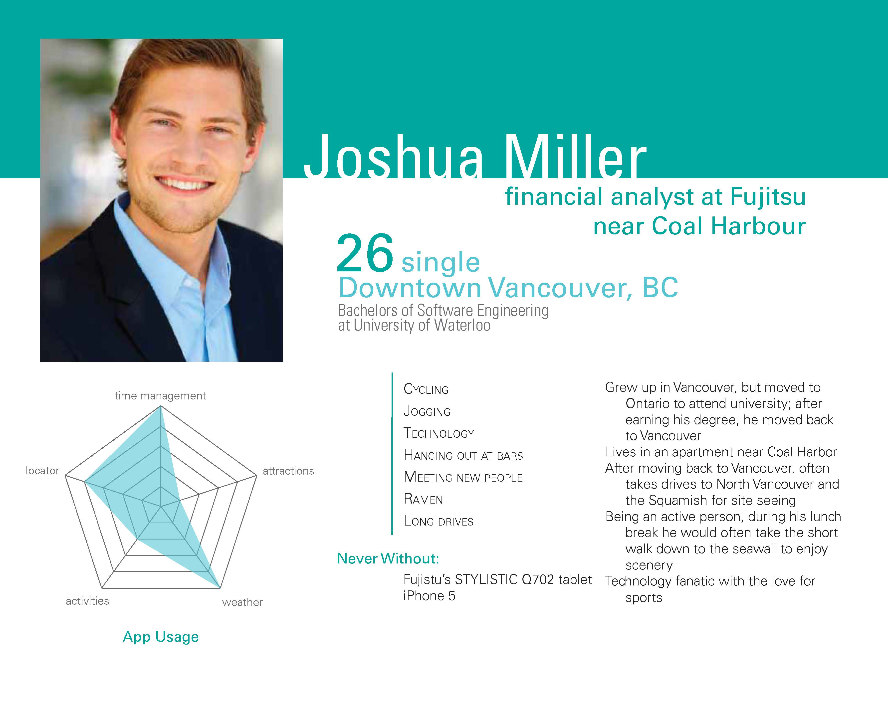

Slide 20
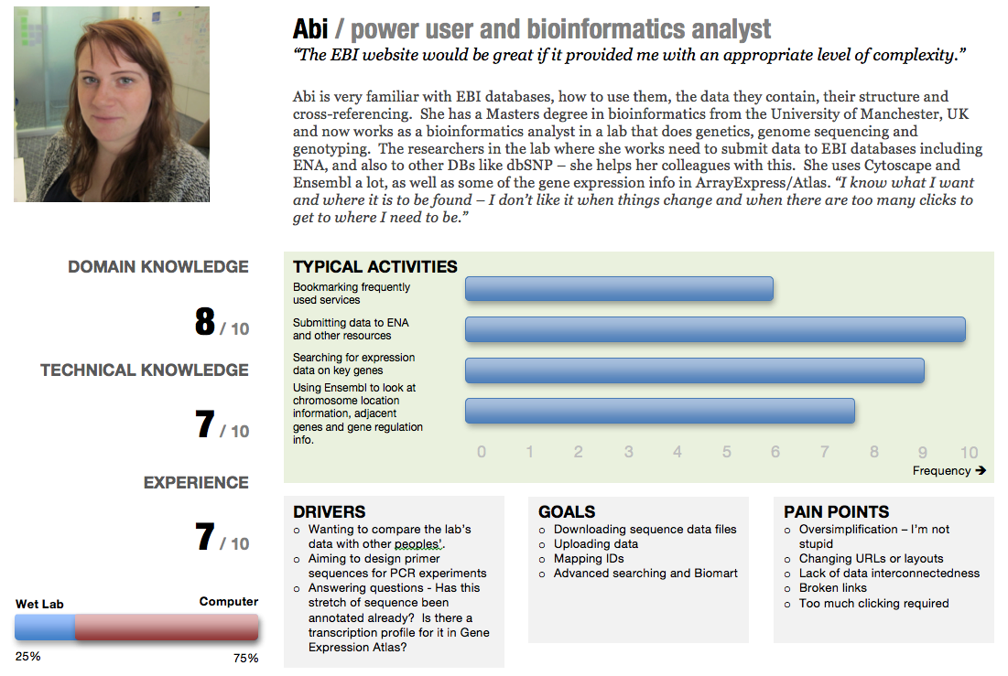

Slide 21
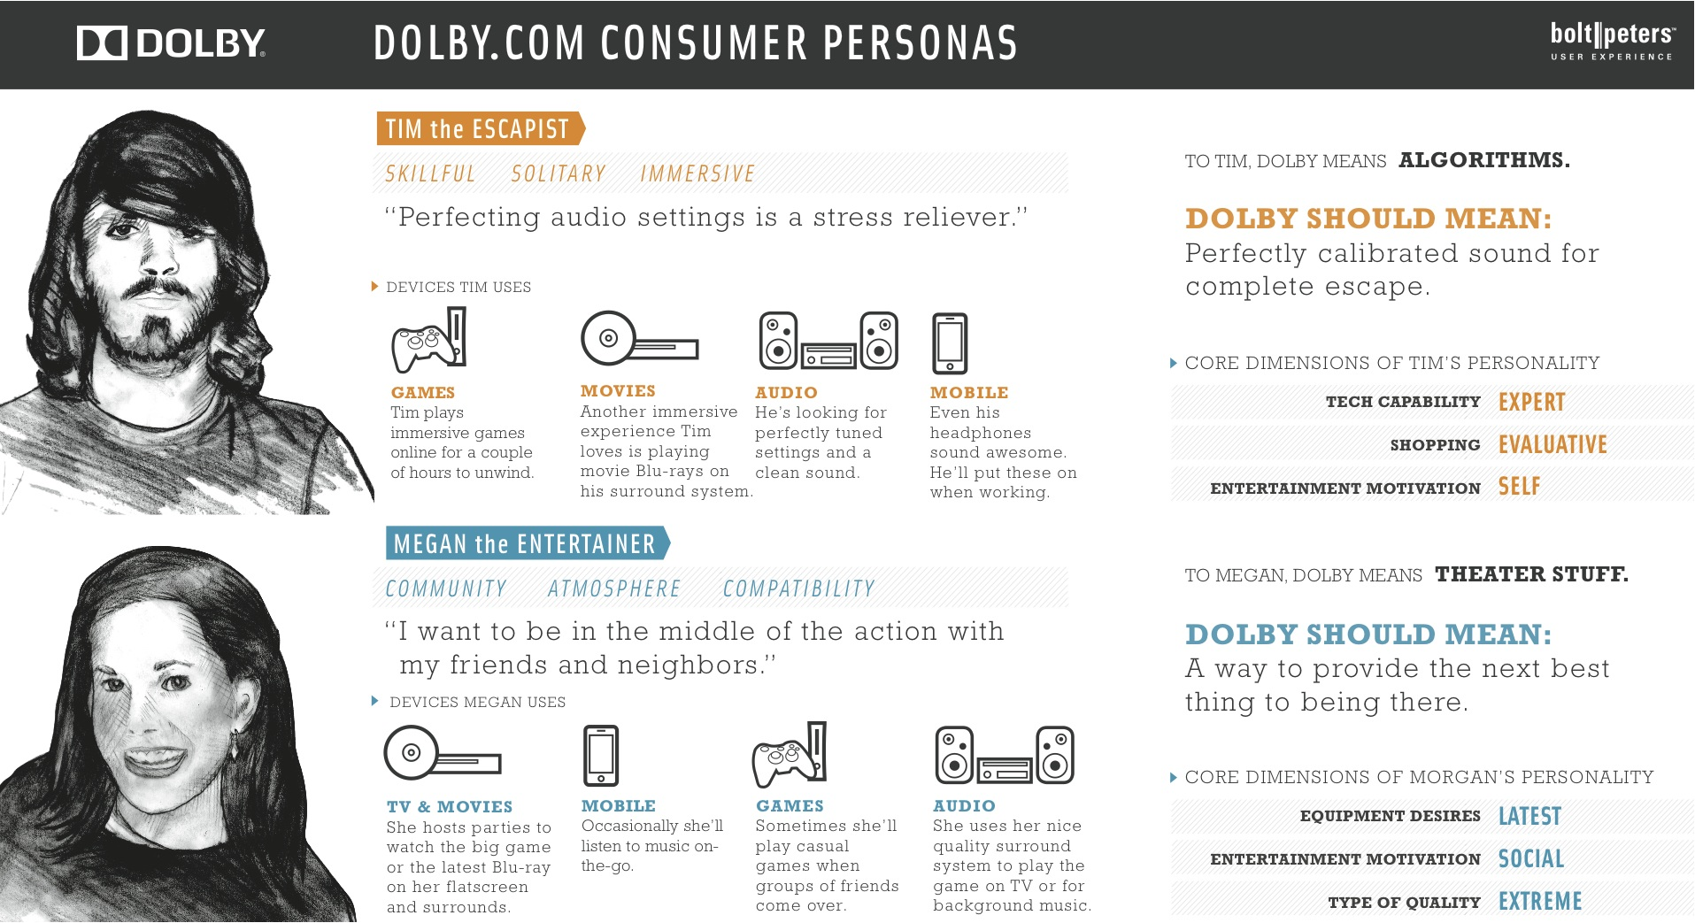

Slide 22
Design challenge 1:
Design Crits
Design crits are a common practice in design driven companies where people get together to analyse each others work
The key in a design crit is that you are presenting your ideas and justifying the choices you have made
Criticism should be constructive not destructive
What makes something constructive criticism?
Focus on the process
Suggest improvements
Highlight what doesn’t need to change
Design crits have a bad reputation in some communities precisely because they are not done constructively but are key to developing your skills as a designer

Slide 23
Design challenge 1:
Reducing the number of concepts
Try to look for common themes across the sketches that you have produced and analyse them in relation to your personas
Look at another person work and talk about it
At this point, if you like, you can produce other sketches based on the ideas that you have produced so far

Slide 24
Design challenge 1:
Selection and elaboration
As a group, chose the most promising design concept as a staring point – argue for your favourites using your persona
Produce 10 details and/or variations of that particular design concept
Detail what exactly the people involved have to do
Try out slight variations on your concepts
Don’t limit your thinking yet
Remember, your designs are to evoke or guide an experience with the device, what is that experience going to be?

Slide 25
Group challenge
You will be working your groups of 6-8 for this task.
I would recommend starting out by sketching out designs individually like you did in the first exercise but where do you go from there?
Pass the idea
Dividing the dollar?
Card sorting?
Why?
Key challenge – how are you going to present your ideas at the end of the session?

Slide 26
Group challenge: UX in Dementia Care
Your team has been brought in to help a home-care technology company that specialises in designing technology to help people living with dementia and their caregivers.
Dementia is a global decline in cognitive ability caused by several diseases typically associated with ageing and affecting
Memory – short term and long term
Ability to perform tasks of daily living
Emotional control

Slide 27
Group challenge: UX in Dementia Care
Some common problems that people living with dementia and their caregivers face include:
Completing Basic Activities of Daily Living
Wandering Behaviour
Social isolation and remembering peoples names and faces
Entertainment and boredom
Some activities that people with dementia like to engage in include
Reminiscence therapy
Hobbies and crafts
Singing and listening to music
Safe Walking

Slide 28
Design Games: Pass the idea
Each player has 2 minutes to document an idea as best as they can on paper
After the time is up, you “pass the idea” around the circle until the music stops
You now have a new idea to improve as much as you can in 2 minutes
After improvement, you present the idea you received and improved to the group and vote on a winner - the 2 people who made it both get 2 points
Repeat as many times as appropriate

Slide 29
Design Games: Card Sorting
Each person gets (Creates) a list of all of the “things” that they can think of in relation to a topic on post-it notes (or cards)
Find a free chunk of wall and start to put up and group together your post-its
Create hierarchies to sort the cards and agree on labels for them
This system can be used to
Generate a menu-system for your final app
Decide priorities in a system
Create a topic-guide for an interview
Understand how people think about certain information

Slide 30
Design Games: Dividing the dollar
Create a list of possible features based off all of the features and ideas your group has developed so far in the previous sections
Everyone has £100 to divide between the features based on their priority and should create their distribution in private
Once you have divided your £100 across the features, use a large sheet of paper to collect all the distributions together and discuss them
Create a final distribution based on the agreed upon score of the group

Slide 31
CSC349 User Experience
Practical 3 – Scenarios in Design

Slide 32
The many applications of Scenarios in Design
Scenarios used for capturing data gathered in your scoping or other user engagement (sometimes called Requirements Capture in Software engineering):
Scenarios (or Current Scenarios)
Use Cases and Use Case Diagrams
(Hierarchical) Task Analysis
Scenarios that are directly applied to help with the design and envisionment process and benefit from being more “sketchy”
Future Scenarios
Storyboarding
Pastiche Scenarios

Slide 33
(Current) Scenarios
The original application of scenarios in design was by J Carroll and leverages the natural tendency of people to tell stories to explain their work or lives
Scenarios consist of short, textual descriptions of a current common scenario in the space you are designing for
Scenarios can be generated from observation, brainstorming or other user scoping
Scenarios can also be constructed in collaboration with your future users in workshops or focus groups as a form of shared output
Notes:
Then what happens? We have a raft of issues to address
three's no clear cut law of emergence vs. convergence

Slide 34
Current Scenarios Example
For a data entry team:
“Well, this is where the admissions forms arrive. We receive about 50 a day during the peak application period. Brian will open the forms and check that they are complete that is all the documentation has been included. You see we require copies of relevant school exam results and evidence of work experience before we can process the applications. Depending on the results of this, we either pass them on to….”

Slide 35
Current Scenarios
Pair up with a partner.

Slide 36
Use Cases
Use cases focus on user goals and how this can be realised through user-system interaction
Consider this use case for online shopping
Search for items to purchase
Select item to buy
2.1. If Item out of stock then return to step 1
Enter purchase information
Use cases have actors who do something in the system and a set of actions they will take while interacting with the system

Slide 37
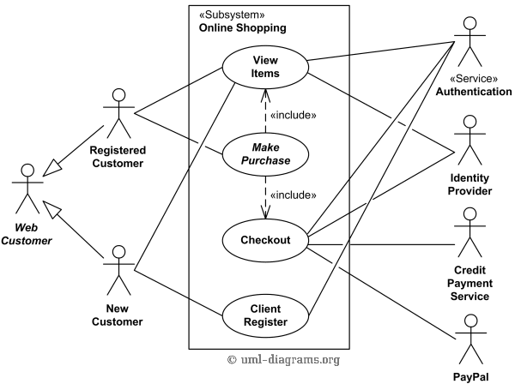
Use Case Diagrams (containing multiple use cases and actors)

Slide 38
Use Case Diagrams and Weaknesses
The Use Case diagram represents all the actors and their use cases in your system so can be considered a more nuanced form of Stakeholder Identification
Also shows the interaction between Use Cases so when more than one actor is involved directly in a Use Case
Weaknesses of this approach are it’s implicit assumption that there is a system to interact with
How would you capture an interaction where you need to phone up to register to use an online shopping system (common in B2B)

Slide 39
Task Analysis
Task Analysis is a structured investigation of how people go about achieving their goals in the real world
There are many forms of Task Analysis but the most common is Hierarchical Task Analysis where steps are broken down into sub-steps
Strengths of Hierarchical Task Analysis are
Allowing an objective comparison of alternative designs
Allowing abstraction in detail for design discussions
Supporting design re-use
Weaknesses
Parallelisation not possible
Doesn’t scale well with complexity
Notes:
Then what happens? We have a raft of issues to address
three's no clear cut law of emergence vs. convergence

Slide 40
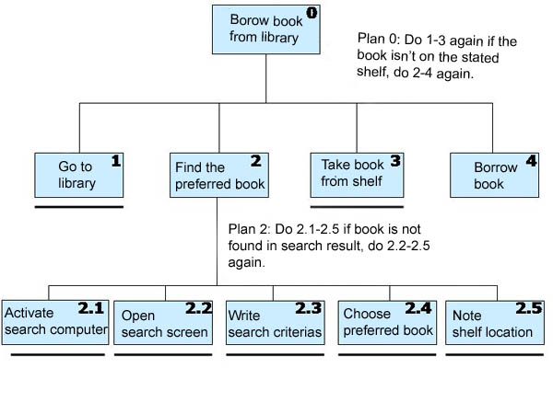

Slide 41
Future Scenarios
A common alternative to the Current Scenario approach that rapidly emerged
Simple, textual descriptions of how a person might interact with a future piece of technology that motivate how you can design and develop the technology
Excellent for placing a strong emphasis on the UX of a product because you tell a story about it
And can focus on negative as well as positive UX to motivate design
Strong crossover with Persona in Future Scenario work

Slide 42
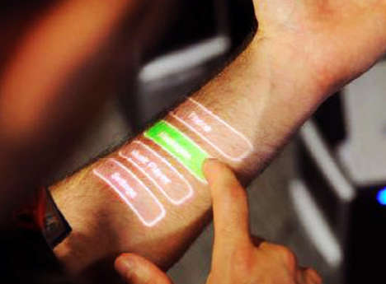
Future Scenarios Example: Skinput
“Neal has just finished his run, he likes listening to music and has been playing his favourite piece. Skinput is great for him, he can focus on running while scrolling through songs. With a flick of his fingers, he turns off the music and opens up the TV remote on his forearm and selects his favourite show. Feeling hungry, he pulls up a list of potential recipes on his arm based off the food currently in his kitchen…”

Slide 43
What have we been missing out on in all our previous design techniques?

Slide 44
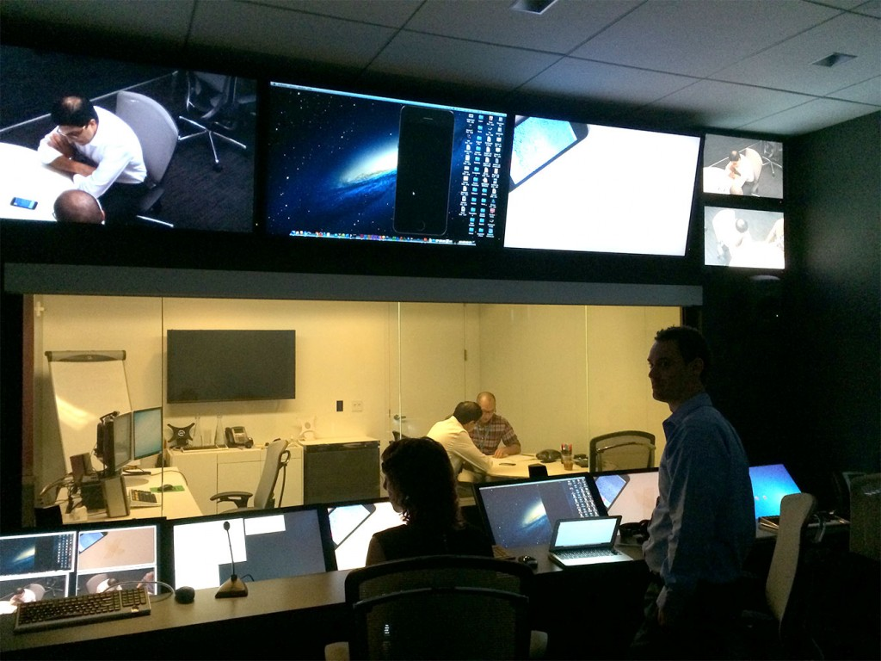

Slide 45
Storyboarding
A further, specific refinement to future scenarios in which designers sketch imagined experiences with a design
One of the most prevalent types of design activity, intuitively understood by many people
SO far, we have talked about ways to document desing concepts and share them with other designers but how do we present our results to end users?
As an approach, storyboarding benefits from being “sketchy” but can also be a technique for presenting a finished design
Ambiguity, rapid production and refinement, openness to change

Slide 46
Storyboarding: Key Qualities
Help to place the focus not just on the design but also on:
The wider context of use – where will this be used, who will be around you, what time of day is it, what are you doing at the same time as this task, etc.
The panels before and after you use the technology are most important ones to focus on
The User Experience with a device again prioritised in this approach

Slide 47
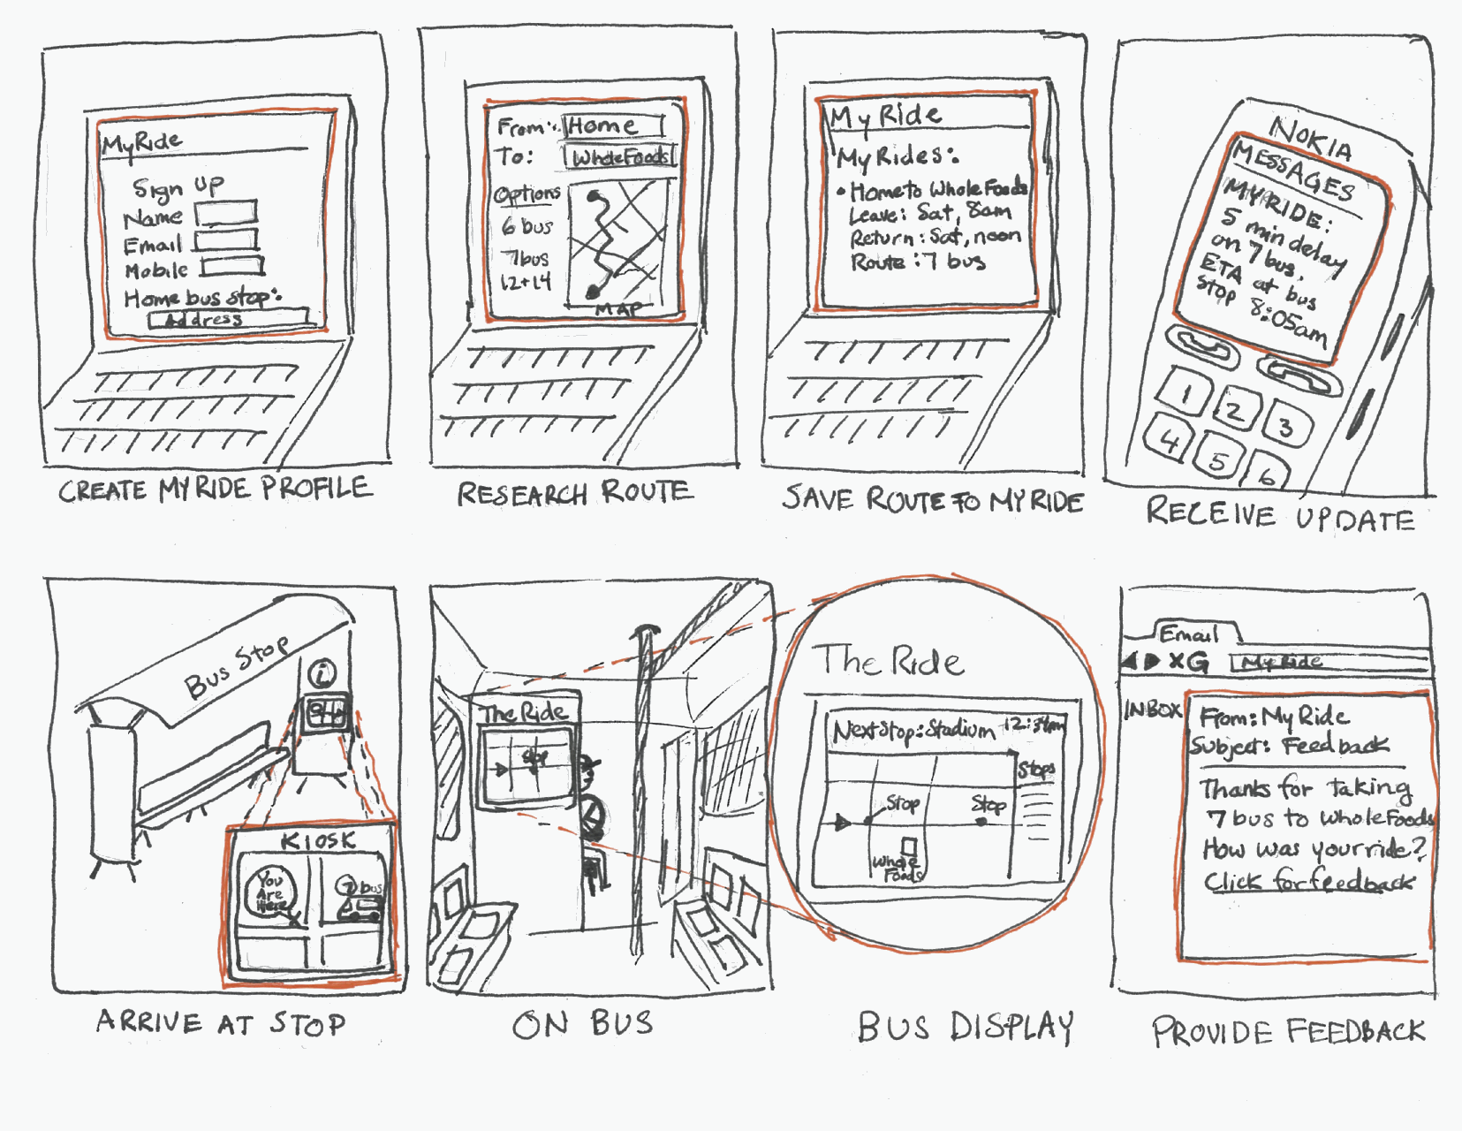

Slide 48
A Novel Approach: Pastiche Scenarios
Pastiche Scenarios are short stories about famous, fictional characters using different designs, what does Scrooge McDuck think of online banking, how does Donald Trump (I choose to believe he’s a fictional character) feel about your companies website?
The benefits of the approach include
More relatable, shareable characters and scenarios
Characters that are often imperfect in their use of technology
Drawbacks
You need to have some basic writing ability
Pastiches aren’t always seen as particularly serious
Notes:
Then what happens? We have a raft of issues to address
three's no clear cut law of emergence vs. convergence

Slide 49
‘‘Look around, around, around around round’ Beatles suggest. I do and the landscape doesn’t seem so bleak. For a moment I feel all sixties. Yes, everything is beautiful, even youth in front of me. And of course he’s not a mugger just because he likes baseball caps. Peace, love, yes. Then abrupt stop. Forgotten charge wretched iPod.’’
Notes:
Law – file sharing websites and copyright
Markets – The CD player staayed looong past it’s sell by date because the market wanted it to
Social norm that effects technology – mobile phones in Japan
Architecture – high speed broadband availability and movie streaming
TRAN: Let’s talk about law and law making a little more

Slide 50
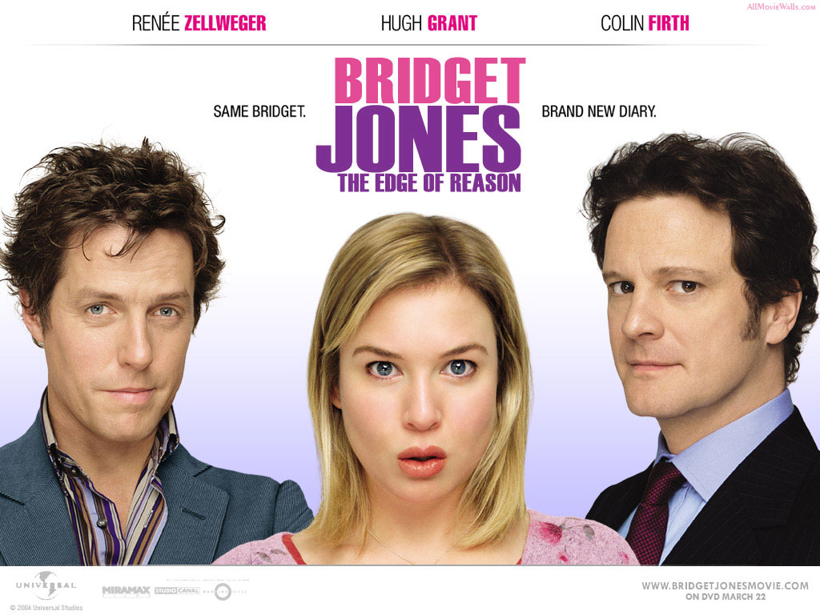
Notes:
Law – file sharing websites and copyright
Markets – The CD player staayed looong past it’s sell by date because the market wanted it to
Social norm that effects technology – mobile phones in Japan
Architecture – high speed broadband availability and movie streaming
TRAN: Let’s talk about law and law making a little more

